Slide 1
Class XLIII
Presenting Sponsor:

Slide 2
Education and Talent: Building a Pipeline for the Future

Slide 3
Upcoming Events & Sessions
Monday, March 6 at 7 p.m. Detroit Pistons vs. Portland Trail Blazers at Little Caesars Arena
Thursday, March 16 Politics and Local Government at The Corner Ballpark
Tuesday, April 4 at 5 p.m. Alumni Fundraiser at BasBlue
Thursday, April 13 Arts & Culture Session at Detroit Public Theatre
Wednesday, April 26 at 10 a.m. Day in Lansing
Wednesday, May 3 Future of Mobility Session
Thursday, May 11 Neighborhood Revitalization Session at The Stoudamire (Eastside Community Network)
Wednesday, June 14 at 5 p.m. Graduation Ceremony and Reception at Huntington Tower

Slide 4
Amber Arellano
Executive Director
Education Trust-Midwest
LDXXXVII

Slide 5
Building Blocks: Importance of P-12 Education

Slide 6
Presentation Roadmap
Learning from other states:
Massachusetts
Tennessee
The Michigan Context
Michigan's performance over time
School Funding Equity
Detroit-Specific Data

Slide 7
Massachusetts

Slide 8
Massachusetts's Efforts in the early 1990s set the state on a path to success
Massachusetts Strategies for Success:
Effective Teaching and School Leadership
Career- and College-Reading Expectations for all Students
Support for all Teachers
Charter Schools’ Grand Bargain
Fair Funding

Slide 9
Massachusetts remains the top-performing state in the nation in Grade 4 Reading
Massachusetts
Michigan

Slide 10
Massachusetts remains the top-performing state in the nation in Grade 8 Math
Massachusetts
Michigan

Slide 11
Where is Massachusetts Headed Next?
2019 Student Opportunity Act
Gold standard for equity in school funding.
Recognition that the experience of living in poverty is not the same in all locations.
Massachusetts is phasing in weights of 40% - 101% for students who live in concentrated poverty.
Simply put: the greater the students' needs, the higher the funding weights.

Slide 12
Tennessee

Slide 13
Tennessee's Investments over the past 15 years have resulted in significant improvements for students
In 2007, Tennessee ranked below Michigan in 4th grade reading and math.
In 2013, Tennessee ranked 37th compared to Michigan's 42nd in 4th grade math.
Today: While all states are feeling the effects of the pandemic, Tennessee still outperforms Michigan in both early reading and math on national assessments.
​
The difference: Tennessee adopted Massachusetts-like strategies to improve its teaching and learning. ​
​
The Result: Tennessee has seen significant improvement in student outcomes over time.

Slide 14
Tennessee shows dramatic achievement gains for Black students over the past 20 years
Average Change in Scale Score
NAEP Grade 4 – Reading – Black Students (2003-2022)
Notes:
Needs datacheck – BK complete

Slide 15
Michigan

Slide 16
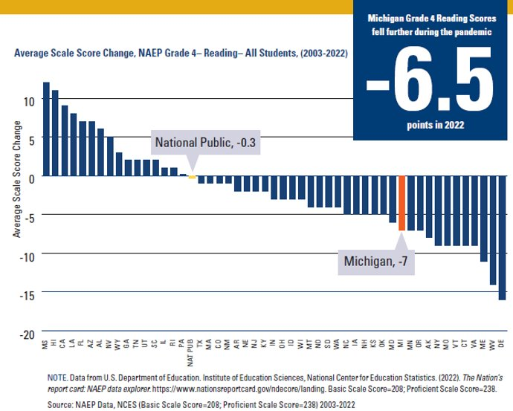
Michigan's Learning Loss Over Time – 4th Grade Reading
Between 2003 and 2019, Michigan’s 4th grade reading scores, though they fluctuated, fell by half a point by the end of that 16-year period.
Between 2019 and 2022, Michigan’s scores fell a further 6.5 points, for a total decline of 7 points since 2003.
Michigan is now ranked 43rd in 4th grade reading for all students.
Source: NCES, NAEP Data Explorer
Notes:
Needs datacheck – BK complete

Slide 17
NAEP 2003-2022 – Michigan Relative Ranks by Student Subgroup
Michigan NAEP -4th Grade Reading Relative Rank of Student Subgroups 2003-2022
 | 2003 | 2022
Black Students | 38th/41 | 36th/39
Latino Students | 22nd/40 | 29th/47
Low-Income Students | 35th | 40th
White Students | 13th | 42nd
Higher Income Students | 24th | 22nd/49
Source: NCES, NAEP Data Explorer
Notes:
Needs datacheck – BK complete

Slide 18
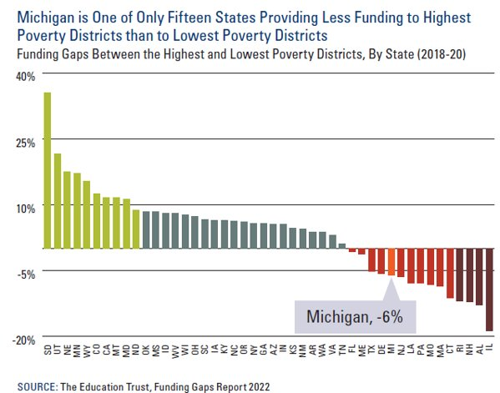
Michigan – Persistent School Funding Inequities
Michigan ranks 36th of 46 states in the nation for funding gaps that negatively impact low-income students.
Michigan's Foundation Allowance of $9,150 is the sixth highest in the nation among states with similar systems.
In short, Michigan's school funding system ranks in the top ten for foundation amount adequacy, but in the bottom 15 for equity.

Slide 19
Proposed K-12 Equity Weights: A Snapshot Comparison
​ | ​ | NATIONAL ​ RESEARCH​ | MICHIGAN STATUS QUO | LEADING ​ STATE EXAMPLES​ | MPEO​
​ | ​ Students ​ from ​ Low-Income Families​ ​ | 100–200% more ​ (e.g. 2 to 3x as much)​ | 11.5% more | MA: will allocate up to 105% more*​ MD: 73% more*​ | Opportunity Index​ ​ At least 100% more at top of index​ (e.g. 2x as much)​
​ | ​ | ​ |  | ​ | ​
​ | English Learner Students​ | 100–150% more ​ (e.g. 2 to 2.5x as much)​ | 1%-11% more | GA: 159% more ​ MD: 85% more*​ MA: will allocate ​ 29–33% more​ | At least ​ 75–100% more​
*Note: MA and MD are phasing in these weights over time.

Slide 20
Comparison between Boston and Detroit – Grade 4 Reading: All Students
Change in Scale Score Over Time
NAEP Grade 4 – Reading – All Students (2009-2022)
Notes:
Needs datacheck – BK Complete

Slide 21
Comparison between Boston and Detroit – Grade 4 Reading: Students from Low-Income Backgrounds
Change in Scale Score Over Time
NAEP Grade 4 – Reading – Low-Income Students (2009-2022)
Notes:
Needs datacheck – BK Data Check Complete

Slide 22
Comparison between Boston and Detroit – Grade 4 Reading: Black Students
Change in Scale Score Over Time
NAEP Grade 4 – Reading – Black Students (2009-2022)
Notes:
Needs datacheck – BK Data Check Complete

Slide 23
Comparison between Boston and Detroit – Grade 4 Reading: Latino Students
Change in Scale Score Over Time
NAEP Grade 4 – Reading – Latino Students (2009-2022)
Notes:
Needs datacheck – BK Data Check Complete

Slide 24
Detroit remains lowest-ranked large urban district in the nation in grade 4 reading
Detroit TUDA Performance NAEP Grade 4 – Reading – All Students (2022)
Source: NCES, NAEP Data Explorer
Note: Proficient Scale Score = 238; Basic Scale Score = 208
© 2023 THE EDUCATION TRUST-MIDWEST

Slide 25
Creating a Legacy of Equity
Opportunity 10 Recommendations
Invest with Urgency in Michigan Students’ Educational Recovery
Be Honest about Student Performance
Create a Fair School Funding System
Develop a Strong System of Fiscal Transparency and Accountability for Spending
Prioritize Educator Recruitment, Retention, and Support
Ensure Full Access to Rigorous Coursework and Preparation for All Michigan Students
Reimagine Early Literacy
Identify Students with Dyslexia and Ensure They Receive the Support They Need
Invest in Post-Secondary Innovation
Strengthen Early Childhood for Students Who are Underserved

Slide 26
Discussion
26

Slide 27
Building Blocks: Importance of P-12 Education
Amber Arellano, Executive Director, Education Trust-Midwest, LDXXXVII
Jack Elsey, Founder, Michigan Educator Workforce Initiative, LDXLI
Lou Glazer, President, Michigan Future Inc.

Slide 28
Michigan
Educator
Workforce
Initiative
Organization
Overview

Slide 29
MEWI: Supporting Educators to Enable Students
The Michigan Educator Workforce Initiative believes quality talent -from teachers to principals and systems leaders - is critical to improving K-12 school performance.
While MEWI is a new organization founded in 2022, the team has 40+ years of educator talent experience, working to ensure Michigan’s children have access to
great educators.
School-based
expertise
MEWI believes that high-performing schools are made possible by well- trained, committed educators who are equipped to deliver their best, every day.
(0
E
® <z>
Creating a
Ic
w .2
Track Record of
_ u
Q. Q) CD Q,
Q Hi
2

Slide 30
3

Slide 31
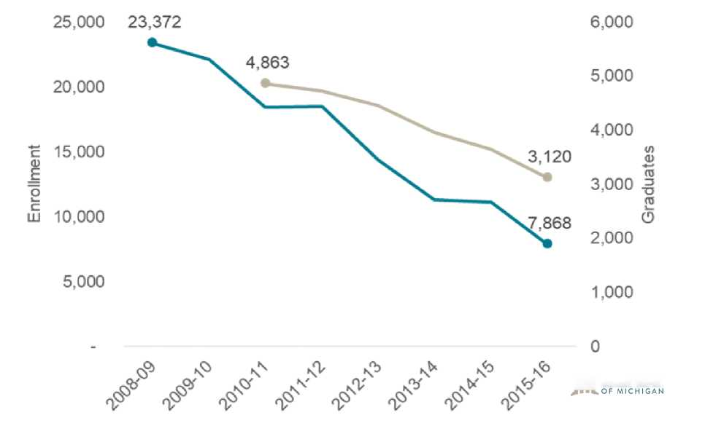
Michigan’s Shortage is Among the Most Acute in U.S.
Drops in teacher prep program enrollment and low retention rates have created significant challenges, outpacing the state’s population loss.
140,000 1,712,133
1,800,000
Teachers
60,000
800,000
600,000
400.000
200.000
40,000
20,000
.<$> & \^{N} N> V> V* »$>
AT c&r A' AT at & _{N}v _{N}or & &
rf <$> cf ^ ^ ^ ^ ^ ^
VjrCITIZENS
^15^ CITIZENS
illl RESEARCH COUNCIL
Cflll pcccrtDrurnii.ini
JHlc
Teacher losses outpace student population loss
66% enrollment drop in educator preparation programs
4

Slide 32
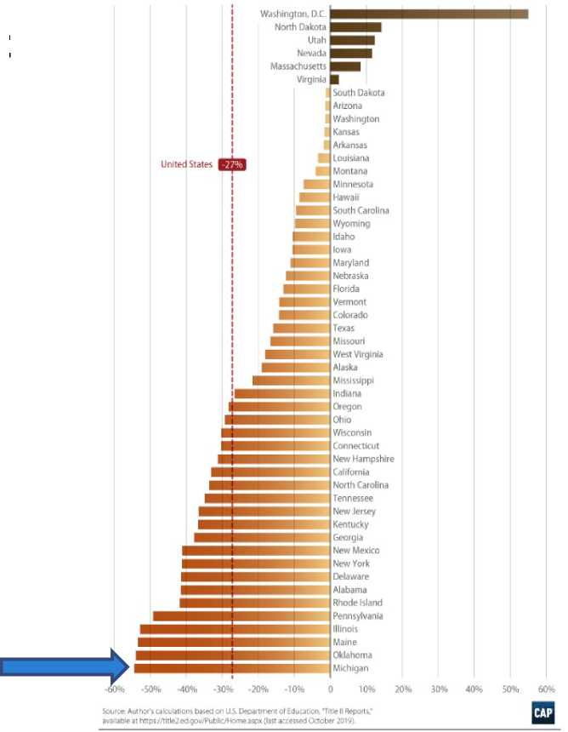
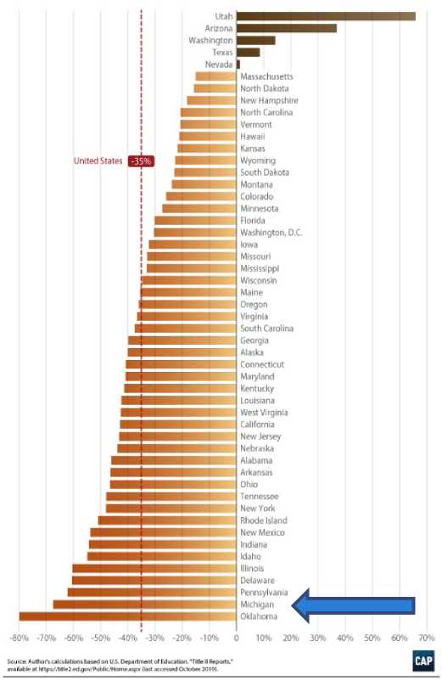
Michigan’s Decline is the Most Acute in the Country
Michigan’s waning educator pipeline means it is not prepared to educate all its kids in the
years ahead.
Michigan is second-to-last in the country with a 66% drop in EPP enrollment
since 2008
It's last in the country with a 55% drop in EPP completion rates in the
same time period.
Both are double the national average.
5

Slide 33
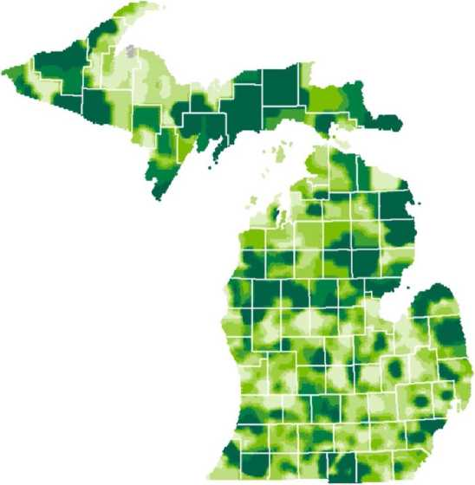
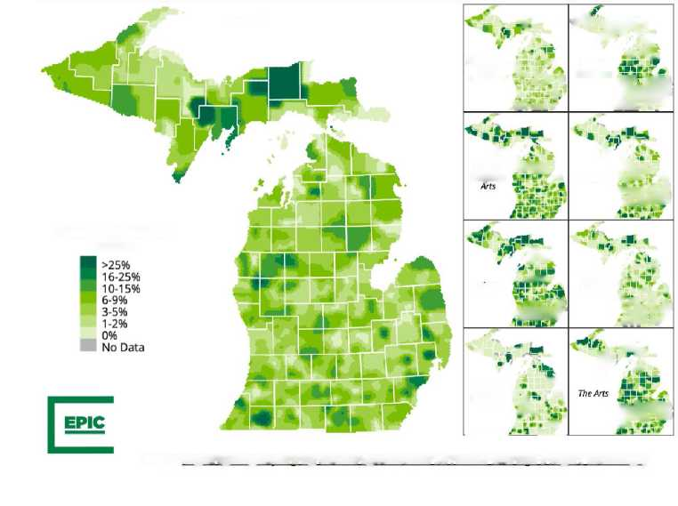
Michigan’s Teacher Needs are Widespread
Finding teachers is not a problem unique to certain geographies, though it is more acute in some.
Highest-Need Regions
Teacher Vacancies in Ml
Teacher Shortages in Michigan Vary Widely at the Local Level, Even Between Close Neighboring Districts
Districts Are Relying More on Under-Credentialed Teachers to Meet Their Staffing Needs
Percent of Teachers Who Are Not Certified and/or Not Appropriately Endorsed for Their Teaching Assignment
Increases in temporary credentials issued from 2018-19 to 2021-22:
Full-year substitute teaching permits:
+141%
Extended daily substitute teaching permits: +51%
Science teachers, and in some areas of the state, ELA and special education teachers are the most likely to be under-credentialed.
Estimated Extent of Teacher Shortage (Overall)
H Greatest
I Elementary ■= » Self- fi Contained "" _{t}f £ ’'ii i J- ffimw | ***£ a S .m Special Education HsM Jxrrr
* English CW Language •» | t . ft* Math iifWL * 'SM
A. . jn Science r.Mi , * '?• •MBUf’ | • ^ -- K Social ,■ Studies - in _ ’ .’i 'if? i, lm.£V ii:’ .!?-* V^{r}
' ■ World m - Language ^{e}j« ^ sX . 1^ _if_ | siL V IT ViJSffiS ■na IP -r*i
Overall
Least No data
Source: httDs://eoicedoolia.ors/wD- content/uoloads/2022/12/Teacher-Shonaee-
ll-Reoon Ian2023.pdf
Under-credentialed
Teachers
Source: https://epicedpolicv. org/wp-content/uploads/2022/12/Teocher-Sh ortaze-H-Report Ian2023.pdf
6

Slide 34
The Market Does Not Support the Need
And negatively affects Michigan’s most vulnerable populations
Teacher Preparation
In each year since the onset of the COVID-19 pandemic,
Teacher Exits (District and State)
by Black and Economically Disadvantaged Student Populations and Year, Fall 2010 to Fall 2019
Michigan has issued fewer initial teaching certificates in all grade ranges, subject areas, and educational settings.
16
Teachers issued initial certificates
6K
5K
a
a
Number of Unique Educators
4,195
3,885
4K
3,701
3,495 3,526
3,755
3,749
3,308
3K
2,898
2,549
2,872
2,954
2,771
2K
2010
2011
2012
-+-
2016
2017
2018
2019
1K
 | All Certificate Holders
2013 2014 2015
Overall District Exits
Year (Fall Semester)
Low Percent Economically Disadvantaged High Percent Economically Disadvantaged
| Low Percent Black ■ High Percent Black ■
2012-13 2013-14
2014-15
2015-16
2016-17
2017-18
2018-19
2019-20
2020-21 2021-22
Note: Employment status and assignment types come from the Registry of Educational Personnel (REP) fall collection. Student enrollment data come from the Center for Educational Performance and Information (CEPI), Student Enrollment Count Report (2020-21, Statewide, accessed April 1,2021).
Source: https://epicedpolicv.ors/wp-content/uDloads/2021/05/Teacher Workforce Pol Brief Mav2021.pdf
Note: Teacher supply issues are not going to be solved by an influx of new certified teachers because these numbers are declining as well. Source: https://epicedpolicv. ors/wp-content/uploads/2022/12/Teacher-Shortase-ll-Report Ian2023.pdf
7

Slide 35
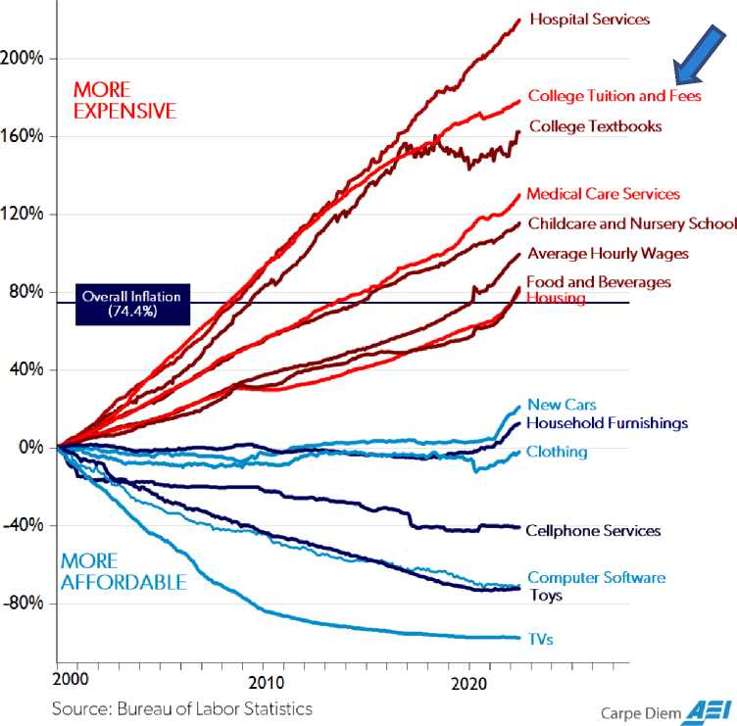
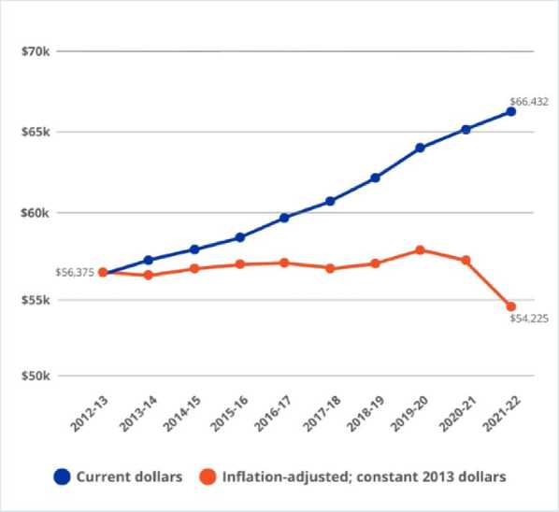
While Costs of College... Soar.
Becoming a teacher is becoming more cost-prohibitive, especially as teacher salaries remain less competitive than other sectors.
Price Changes: January 2000 to June 2022
Selected US Consumer Goods and Services, Wages
The Decline in Average Teacher Pay
Teachers make on average $2,150 less than they did 10 years ago, adjusted for inflation.
Source: Rankings & Estimates, NEA Research, June 2022.
8

Slide 36
RESPONDING TO THE EDUCATOR SHORTAGE
Long-term investments - enabled by the American Rescue Plan, State Investments and bolstered by philanthropy - are critical for Michigan to become a more competitive and higher performing state.
Current Context
At the start of the 2021-22 school year, students were on average four months behind in math and three months behind in reading.
Gap between students in majority-Black schools is widening from majority-White schools since the pandemic
Teachers, who are already facing shortages and challenges within districts, have students with a broad range of experiences from the past two years, requiring additional support and needs in tailoring instruction
Michigan’s Teacher Shortage is the among the most acute in the country: 66% in educator preparation enrollment in the last decade; lead the country in EPP attrition rate.
Statewide Opportunity
• MEWI is uniquely positioned to bring national partners to districts across the state of Michigan and brings:
• proven results in developing and implementing talent programs with ability to scale success
• a track record of convening and collaborating with partners - especially K-12 systems and national non¬ profits - to address specific programmatic needs
• the tools and capabilities to hold partners accountable to results and act as a fiduciary for program delivery
Comprehensive programs, supported and implemented with K-12 systems leaders, ensure all school systems that need teachers have access to workforce
development efforts they most need.
Source: https://www.mckinsey.com/industries/education/our-insights/covid-19-and-education-an-emerging-k-shaped-recovery
9

Slide 37
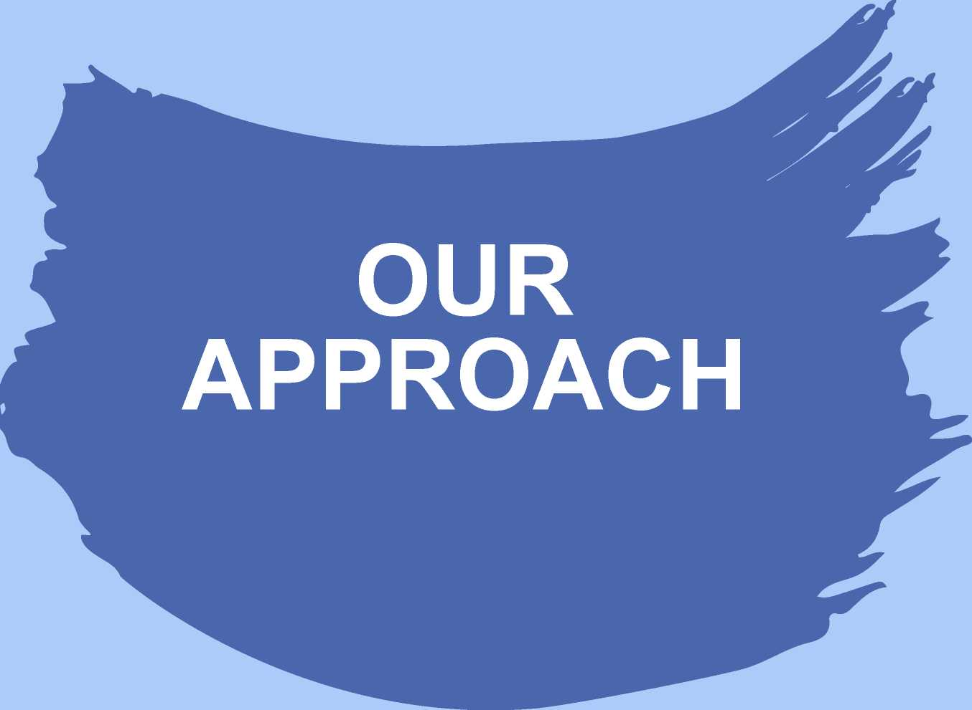
10

Slide 38
Our Approach: An Educator Talent Hub for Michigan
The Michigan Educator Workforce Initiative is a statewide effort to comprehensively transform the educator pipeline in Michigan.
r ^
New
Teachers
Design, Implement, Fund and Support innovative programs for new teacher recruitment and development with a focus on quality and sustainability.
Teacher
Leaders
Design, Implement, Fund and Support innovative programs develop, retain and elevate veteran teachers, with a focus on impact and career achievement.
©
eee
Design, Implement, Fund and Support innovative programs develop, retain and elevate veteran teachers, with a focus on impact and career achievement.
School
Leaders
Research, Policy & Practice
Capture and share insights from best practices and programs with systems leaders, policymakers, parents, and community leaders.
r
Convener
Serve as a hub for educator talent discussions, collaboration, problem-solving, and innovation.
11

Slide 39
: An Experienced Team
Over the past 6 years, MEWI’s team has made investments and designed and developed programs that directly impacted over 60,000 students, 120+ schools, and over 12,000 educators.
Supported school leader and teacher development in over 40 Detroit schools, through two innovative programs: ModEL Schools with DPSCD and the School Collaboration Collective with Detroit charter schools, producing above average student achievement results.
A Record of Success
Trained over 100 aspiring and current school leaders at Detroit Public Schools Community District (DPSCD) by supporting the nationally respected New Leaders program. Currently, over one-third of DPSCD’s newly appointed principals have come from this program. Created state’s first district-run alternate pathway program.
Recruited over 250 teachers into education and from other states to Detroit traditional and charter public schools through partnerships with Teach for America and the Skillman Foundation, and seed-funding two innovative teacher recruitment programs: Professional Innovations in Teaching and Teach 313
12

Slide 40
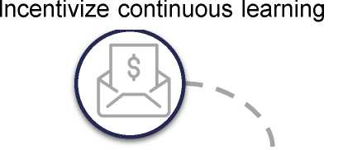
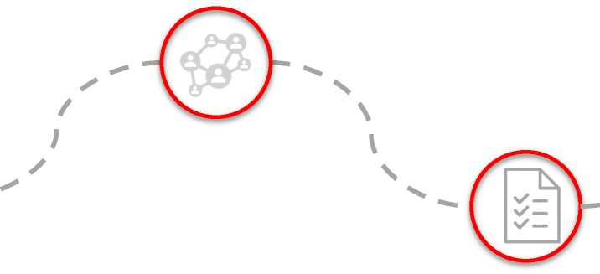
EDUCATOR LIFECYCLE INVESTMENT OPPORTUNITY
Investments can improve the educator experience, focusing on the early educator profile including incentives to join the career path and better support to remain in the profession.
CREATE RETENTION PROGRAMS
Build a pathway to leadership through support for
nationally accredited certification
Enhances learning support for all educators
Build a sense of community and support between new
and more seasoned educators (e.g., formal mentorship
networks)
PROVIDE A PATH TO RETIREMENT
• Increase longevity of teachers by showing a path for retirement
CREATE COMPENSATION PLANS TO INCENTIVIZE LONGEVITY
• Opportunities beyond base salary
• Alleviate early compensation challenges
BUILD TEACHER PIPELINES
• Identification of pipeline opportunities including partnership programs
• Focus on diversity and inclusion throughout talent identification and development
ASSESS PERFORMANCE AND REWARD SUCCESS
• Create transparent metrics and monitor progress.
• Tie directly to student success and outcomes.
O Indicates MEWI Investment Area
O Potential Policy Investment Area

Slide 41
WHAT WE KNOW WORKS
Proven model programs for teacher and school leader recruitment and development that can be scaled across the state of Michigan.
Regionalized Grow-Your-Own (GYO) Programs
• Creating a more robust teacher pipeline within the state
• Increasing teacher diversity to reflect the student population
• Examples: Talent Together, New Paradigm for Education’s Educator Development Institute, DPSCD’s On the Rise Academy
Innovative, Cost-Effective Educator Programs (EPP)
• EPP Design Program pairing expert design and technical partners with EPP leadership teams
• Redesigning teacher preparation that is effective, cost-effective, and focused on practical skills
• Examples: US Prep
Funding
Innovative
Programs
and
Research & Data
Teacher Development Programs
Effective Leadership Development Programs
• Developing highly effective school leaders to support teachers
• Improving teacher retention and student outcomes through effective school leaders
• Examples: New Leaders, Surge Institute, Building Excellent Schools, CT3, Relay
• Developing, challenging, and rewarding teachers through training and support for early and mid-career educators
• Increasing teacher satisfaction and retention
• Examples: Relay Graduate School for Education, CT3, Teach for America, Urban Teachers, Leading Educators
14

Slide 42
Lawrence Technological University Dual Enrollment with Detroit Charters
Jack Elsey, Founder, Michigan Educator Workforce Initiative, LDXLI
Lisa Kujawa, Vice President of Enrollment Management, Lawrence Technological University
John Johnson, Director, Post-Secondary & Alumni Relations, U Prep Schools

Slide 43
Education and Talent: Building a Pipeline for the Future

Slide 44
Ben Jackson
Assistant Superintendent
Detroit Public Schools Community District

Slide 45
Partnerships to Increase Enrollment & Reduce Equity Gaps
Russ Kavalhuna, President, Henry Ford College
Ahmad M. Ezzeddine, Vice President, Academic Student Affairs and Global Engagement, Wayne State University, LDXXX
Gabrielle Scarlatta, Provost & Executive Vice Chancellor for Academic Affairs, University of Michigan Dearborn

Slide 46
Mark Ostach
Chief Executive Officer
Digital Wellness Speaker
LD Class XXX

Slide 47
Courage to Connect: Fostering Connection in a Hybrid Workplace

Slide 48
Building a Magnet for the Future Workforce

Slide 49
Next Session: Politics and Local Government
March 16th 8:30 a.m.
The Corner Ballpark, Detroit

Slide 50
Education and Talent: Building a Pipeline for the Future

Slide 51
Class XLIII
Presenting Sponsor:

